Slide 1
Wine Quality
By Christopher Scott

Slide 2
Feature Importance
A term that applies to techniques that determine the relative importance of an individual attribute towards a target attribute.
Each of the eleven features has an importance, and by calculating each of them, the most significant features can be determined as well as the least significant.

Slide 3
Coefficients Feature Importance
Linear machine learning algorithms fit a model where the prediction is the weighted sum of the input values.
These linear algorithms find a set of coefficients to use in the weighted sum in order to make a prediction.
These coefficients can be used as a feature importance score.
However, nonlinear algorithms do not have this aspect

Slide 4
Decision Tree Feature Importance
Unlike linear algorithms, importance is calculated based on split points such as Gini or entropy.
It can be calculated on a singlular tree or an ensemble such as a random forest.
Conveniently provided by the sklearn library

Slide 5
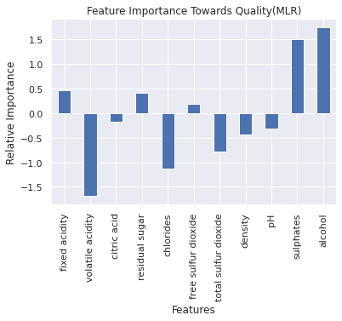
Multiple Linear Regression
Using Multiple Linear Regression, I normalized the data set and calculated and plotted the relative importance of each feature.
Alcohol having the most importance

Slide 6
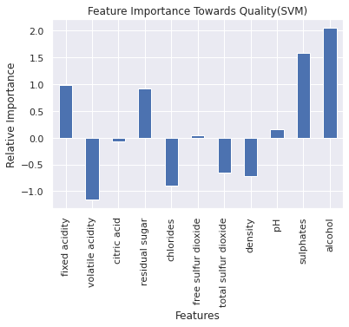
Support Vector Machine (Regression)
Using a Support Vector Regression, similar but slightly varied data was obtained

Slide 7
Random Forest Importance Note
Unlike the other linear methods, there are two
Permutation: No bias towards high cardinality features but more costly than MDI, as features shuffled n times and model is refitted
Mean Decrease in Impurity(MDI): Each importance is calculated as the mean and standard deviation of accumulation of impurity decrease within each tree, but can be invalid with high cardinality features

Slide 8
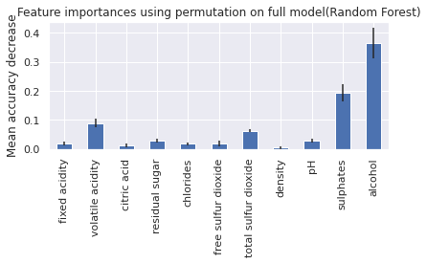
Random Forest Regression (Permutation)

Slide 9
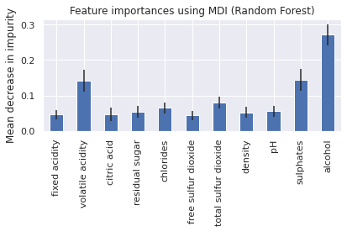
Random Forest Regression (MDI)

Slide 10
Evaluation
To evaluate how well each of the models performed I used their Mean Absolute Error, Mean Squared Error, and Root Mean Squared Error
Of all the models, the Random Forest was consistently the lowest error

Slide 11
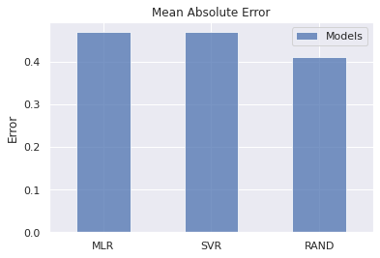
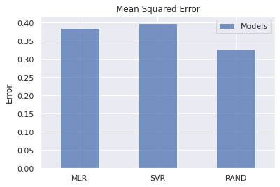
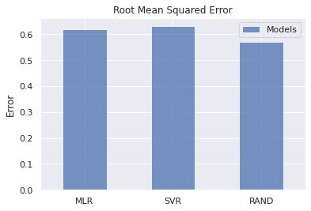
Evaluations Cont.

Slide 12
Results
Through my results, it is apparent that based on my most accurate model, the most relatively important attribute of a wines quality is its alcohol content, followed by sulphates then volatile acidity

Slide 13
Works Cited
"API Reference". Scikit-Learn, 2022, https://scikit-learn.org/stable/modules/classes.html#module-sklearn.svm.
"Feature Importances With A Forest Of Trees". Scikit-Learn, 2022, https://scikit-learn.org/stable/auto_examples/ensemble/plot_forest_importances.html.
"Feature Scaling | Standardization Vs Normalization". Analytics Vidhya, 2022, https://www.analyticsvidhya.com/blog/2020/04/feature-scaling-machine-learning-normalization-standardization/.
"1.4. Support Vector Machines". Scikit-Learn, 2022, https://scikit-learn.org/stable/modules/svm.html.
Brownlee, Jason. "How To Calculate Feature Importance With Python". Machine Learning Mastery, 2022, https://machinelearningmastery.com/calculate-feature-importance-with-python/.
Cortez, Paulo et al. "Modeling Wine Preferences By Data Mining From Physicochemical Properties". Decision Support Systems, vol 47, no. 4, 2009, pp. 547-553. Elsevier BV, https://doi.org/10.1016/j.dss.2009.05.016.
Gupta, Kaustubh. "Plotting Visualizations Out Of Pandas Dataframes - Analytics Vidhya". Analytics Vidhya, 2021, https://www.analyticsvidhya.com/blog/2021/06/plotting-visualizations-out-of-pandas-dataframes/.

Slide 14
This work is licensed under a Creative Commons Attribution-ShareAlike 3.0 Unported License.
It makes use of the works of
Kelly Loves Whales and Nick Merritt.

